Slide 1
Policy Simulator
Policy Simulator for Identity and Access Management allow policies lets you see how a change to an allow policy might impact a principal's access before you commit to making the change.
You can use Policy Simulator to ensure that the changes you're making won't cause a principal to lose access that they need.
It uses access logs to focus on the permission changes that would actually affect your users.
Policy Simulator determines which access attempts from the last 90 days have different results under the proposed allow policy and the current allow policy. Then, it reports these results as a list of access changes.

Slide 2
How it Works
Retrieves access logs for supported resource types from the last 90 days. Where these logs are collected from depends on the resource whose allow policy you're simulating:
Re-evaluates, or replays, the access attempts recorded in the access logs using the current allow policies, taking into account any inherited allow policies and any allow policies set on descendant resources.
Replays the access attempts again using the proposed allow policy, once more taking into account any inherited allow policies and any allow policies set on descendant resources.
Compares the results from the two replays and reports the differences, which show how the proposed changes would affect the principal's access.

Slide 3
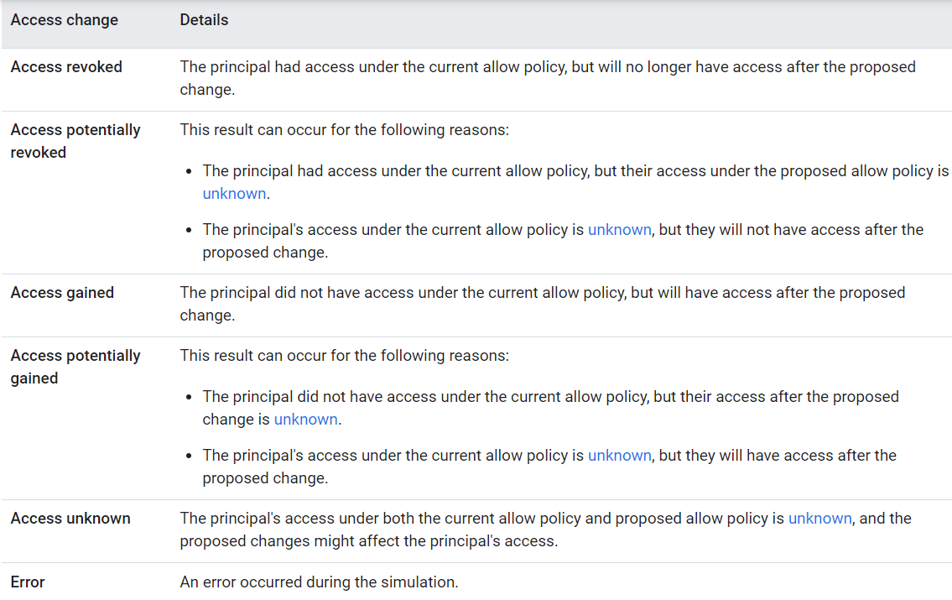
Policy Simulator results

Slide 4
Supported resource types
Cloud Storage
Pub/Sub
Cloud SQL
Spanner
Resource Manager
Compute Engine

